Slide 1

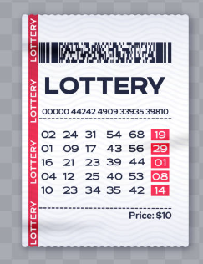
Lottery Winning Number
Is it totally random?

Slide 2
Background:
Everyone wants to know the trick to win lottery. Is there any rules on picking winning combination?
Audience:
General lottery player who want to find out if any logic behind the winning numbers.
Resource:
Mega Millions
New York Pick 10
Power Ball

Slide 3
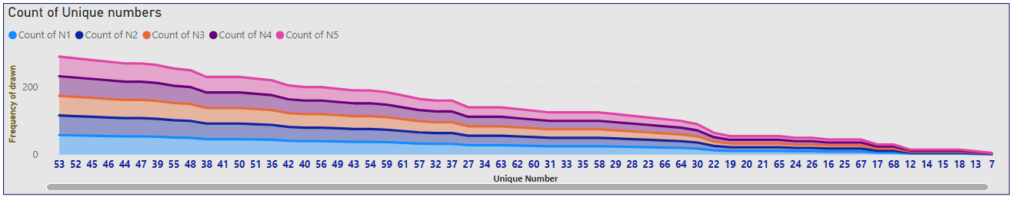
Power Ball:
Number 53, 52, 46, 44, 46 and 47 are most frequent winning numbers picked in every round of draw.
Stacked area chart
Rule of play: Pick 5 numbers between 1 to 69, then pick a number between 1-26 as power ball.

Slide 4
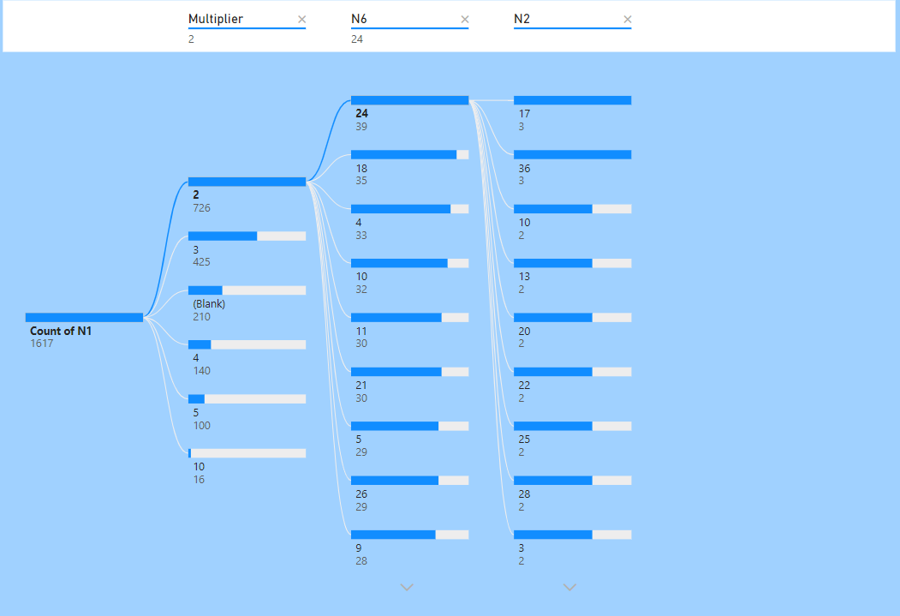
In Power Ball, It is totally random which number is more likely win after one number been drawn
Tree-map chart

Slide 5
NY Pick-10:
Winning numbers being drawn in second round
No dominating numbers as frequently drawn.
At best 10% of chance of being repeated winning number
Counts of winning for each number
Small multiple chart

Slide 6
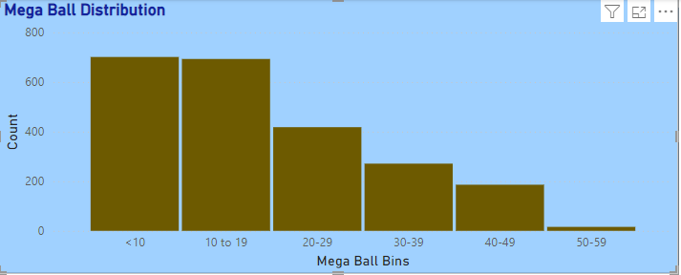
Mega Millions:
Small numbers are more likely to be picked as Mega Ball.
Histogram
Rule of play: Pick 5 numbers between 1 to 70, then pick a number between 1-25 as Mega ball.

Slide 7
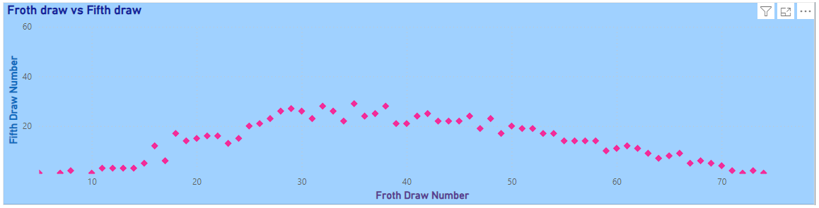
Mega Millions:
No obvious relationship between each draw
Scatter chart

Slide 8
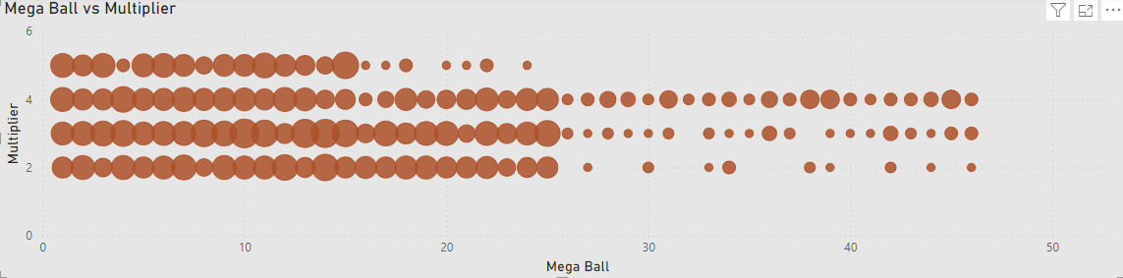
Mega Millions:
No obvious relationship between Multiplier vs Mega Ball number
Bubble chart
Bubble size is the number drawn

Slide 9
Summary and Call of Actions:
There is no logic to pick “winning numbers”.
Higher number are more likely to one of the winning number in power ball.
Play with caution!!

